Slide 1
Einführung in die Programmierung Introduction to Programming Prof. Dr. Bertrand Meyer
Exercise Session 9

Slide 2
Today
Feedback on the mock exam
Recursion
Recursion
Recursion
Recursion
Recursion

Slide 3
Recursion: an example
Fibonacci numbers:
0, 1, 1, 2, 3, 5, 8, 13, 21, 34, 55, ...
How can we calculate the n-th Fibonacci number?
Recursive formula:
F(n) = F(n-1) + F(n-2) for n > 1
with F(0) = 0, F(1) = 1
Notes:
Use the Fibonacci example as a simple remainder of what recursion is about (Fibonacci was also used on one of the lecture slides).
F(0) and F(1) are also called „base case“.

Slide 4
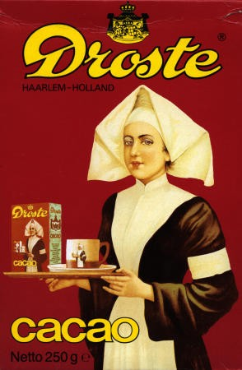
Recursion: a second example
Another example of recursion
Source: en.wikipedia.org/wiki/Recursion

Slide 5
A recursive feature
fibonacci(n: INTEGER): INTEGER
do
if n = 0 then
Result := 0
elseif n = 1 then
Result := 1
else
Result := fibonacci(n-1) +
fibonacci(n-2)
end
end
Calculate fibonacci(4)
3
fib(4)
fib(3)
2
1
fib(2)
1
1
1
0
fib(2)
fib(1)
fib(1)
fib(0)
fib(1)
1
0
fib(0)

Slide 6
The general notion of recursion
A definition for a concept is recursive if it involves an instance of the concept itself
The definition may use more than one “instance of the concept itself ”
Recursion is the use of a recursive definition

Slide 7
Thoughts
„To iterate is human, to recurse - divine!“
but … computers are built by humans
?
Better use iterative approach if reasonable

Slide 8
Iteration vs. recursion
Every recursion could be rewritten as an iteration and vice versa.
BUT, depending on how the problem is formulated, this can be difficult or might not give you a performance improvement.

Slide 9
Exercise: Printing numbers
Hands-On
If we pass n = 4, what will be printed?
print_int (n: INTEGER)
do
print (n)
if n > 1 then
print_int (n - 1)
end
end
print_int (n: INTEGER)
do
if n > 1 then
print_int (n - 1)
end
print (n)
end
4321
1234

Slide 10
Exercise: Reverse string
Hands-On
Print a given string in reverse order using a recursive function.

Slide 11
Exercise: Solution
class APPLICATION
create
make
feature
make
local
s: STRING
do
create s.make_from_string ("poldomangia")
invert(s)
end
invert (s: STRING)
require
s /= Void
do
if not s.is_empty then
invert (s.substring (2, s.count))
print (s[1])
end
end
end

Slide 12
Exercise: Sequences
Hands-On
Write a recursive and an iterative program to print the following:
111,112,113,121,122,123,131,132,133,
211,212,213,221,222,223,231,232,233,
311,312,313,321,322,323,331,332,333,
Note that the recursive solution can use loops too.

Slide 13
Exercise: Recursive solution
cells: ARRAY [INTEGER]
handle_cell (n: INTEGER)
local
i: INTEGER
do
from
i := 1
until
i > 3
loop
cells [n] := i
if (n < 3) then
handle_cell (n+1)
else
print (cells [1].out+cells [2].out+cells [3].out+",")
end
i := i + 1
end
end

Slide 14
Exercise: Iterative solution
from
i := 1
until
i > 3
loop
from
j := 1
until
j > 3
loop
from
k := 1
until
k > 3
loop
print (i.out+j.out+k.out+“,")
k := k + 1
end
j := j + 1
end
i := i + 1
end

