Slide 1
Freefinement
Chair of Software Engineering
Stephan van Staden, Cristiano Calcagno, Bertrand Meyer

Slide 2
Verification systems
Formal systems with judgements t Sat S
Prove whether an inductively defined term t, such as a program, satisfies a specification S
Examples include
type systems: Γ ⊦ e : τ
program logics: {x=3} x := x+2 {x=5}

Slide 3
Refinement calculi
Formal systems with judgements u ⊑ u’
u ::= t | S | ...
Used for top-down development (correctness-by-construction)
Examples (Back/Morgan refinement calculus):
x := x+1; x := x+1 ⊑ x := x+2
x:[x=3,x=5] ⊑ x := x+2
Notes:
Mention that the spec stmt refines to code judgement hints at the fact that one can embed a program logic inside a refinement calculus.

Slide 4
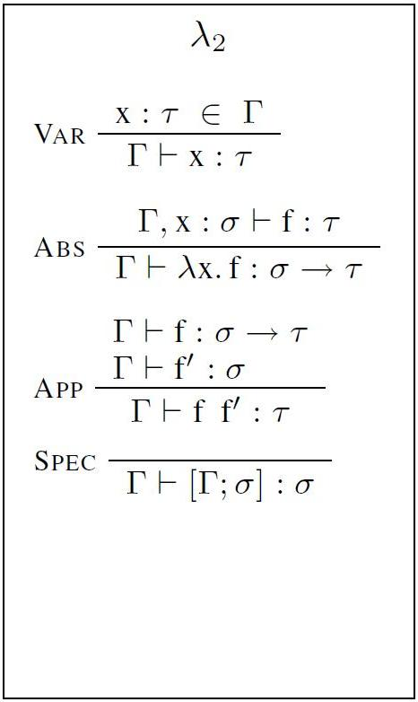
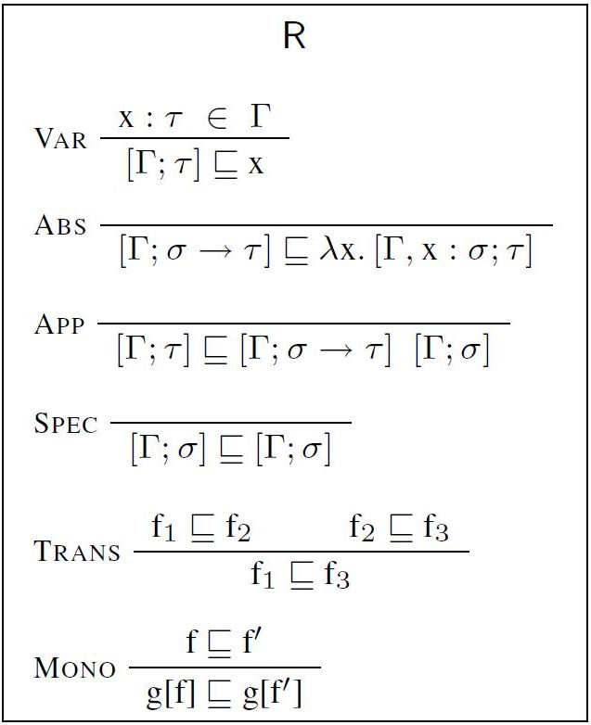
Freefinement is an algorithm
Input:
Verification System
Output 1:
Extended Verif. System
Output 2:
Refinement calculus
Step 1
Step 2
λ₂ proves Γ ⊦ f : τ iff R proves [Γ; τ] ⊑ f
For example,
Γ ⊦ λx. λy. (x y) : (σ→τ)→(σ→τ)
[Γ; (σ→τ)→(σ→τ)] ⊑ λx. λy. (x y)

Slide 5
In a nutshell
Given a verification system V₁ of a particular form, freefinement automatically:
adds specification terms to get a sound and conservative extension V₂, and
constructs a sound refinement calculus R from V₂
V₂ and R are in harmony:
V₂ ⊦ u Sat S ⇔ R ⊦ S ⊑ u
V₂ ⊦ u Sat S and R ⊦ u ⊑ u’ ⇒ V₂ ⊦ u’ Sat S
Can mix top-down (correctness-by-construction) and bottom-up verification
Proof translation is possible
Notes:
Alternative:
Define Harmony as V₂ ⊦ u Sat S ⇔ R ⊦ S ⊑ u
From Harmony and Trans follows
V₂ ⊦ u Sat S & R ⊦ u ⊑ u’ ⇒ V₂ ⊦ u’ Sat S
as well as:
V₂ ⊦ u Sat S & R ⊦ S’ ⊑ S ⇒ V₂ ⊦ u Sat S'
Including Trans in R₁ will save work.

Slide 6
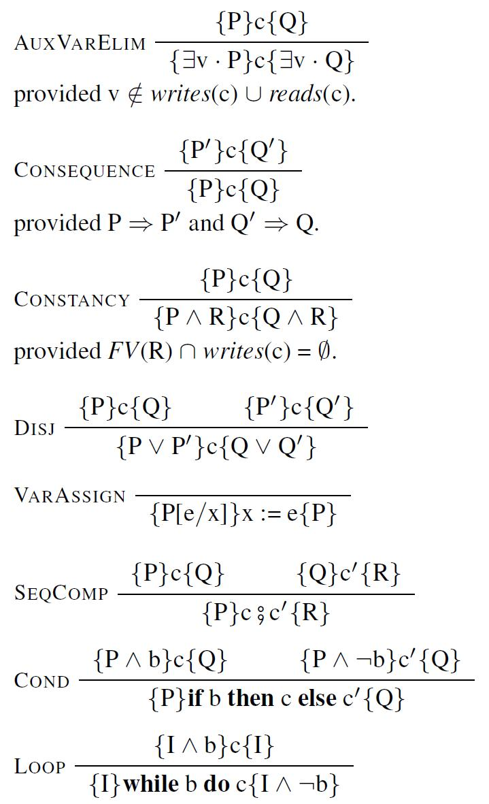
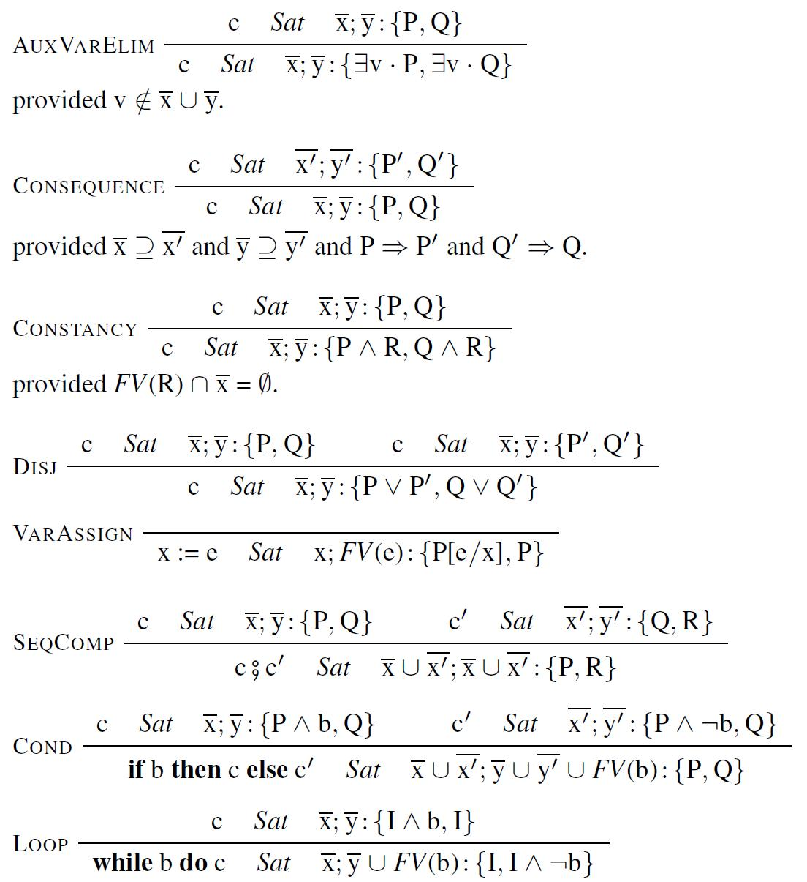
Example: Hoare logic
H
V₁
Preprocess

Slide 7
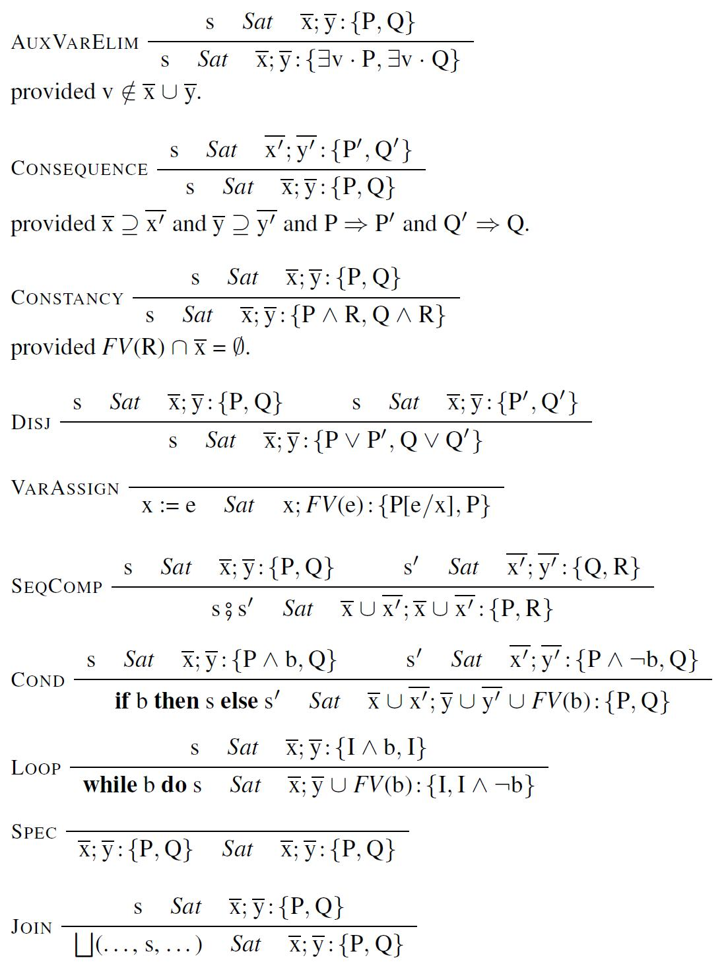
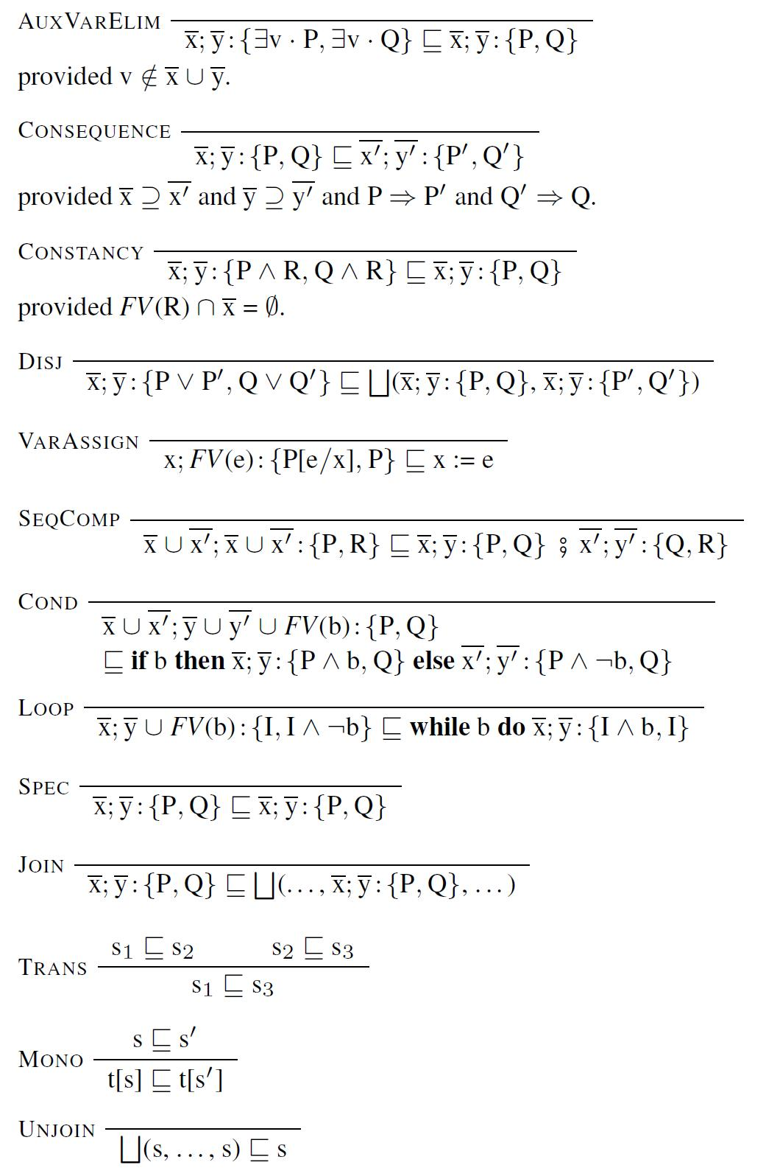
V₂
R

Slide 8
Key aspects in more detail...

Slide 9
Inputs and requirements
A set of constructors for a term language t ::= C(t₁, ..., t_{n})
A set of specifications
A binary relation between terms and specs ⊧_{V1} _ Sat _ . It captures the meaning of satisfaction
A formal system V₁ for proving judgements t Sat S. Two forms of inference rules are allowed: Each rule must be sound w.r.t. the meaning of satisfaction

Slide 10
Extended term language
u ::= C(u₁, ..., u_{n}) | S | ⨆(u₁, ..., u_{n})
Semantics: each extended term u denotes a set of primitive terms ⟦u⟧
Let X denote a set of primitive terms, and Y a set of specifications
Specs(X) ≙ { S | ∀t ∊ X . ⊧_{V1} t Sat S }
Terms(Y) ≙ { t | ∀S ∊ Y . ⊧_{V1} t Sat S }
Galois connection: X ⊆ Terms(Y) ⇔ Y ⊆ Specs(X)
⟦ C(u₁, ..., u_{n}) ⟧ ≙ Terms(Specs(C(⟦u₁⟧, ..., ⟦u_{n}⟧)))
⟦ S ⟧ ≙ Terms({S})
⟦ ⨆(u₁, ..., u_{n}) ⟧ ≙ ⋂_{i ∊ 1..n} ⟦u_{i}⟧

Slide 11
Extended satisfaction and V₂
⊧_{V2} u Sat S ≙ ∀t ∊ ⟦u⟧ . ⊧_{V1} t Sat S
V₂ changes t’s into u’s and adds two rules:
V₂ is a sound and conservative extension of V₁:
V₂ is sound
V₂ can derive everything that V₁ can derive
V₂ uses a richer semantics: ⊧_{V2} t Sat S ⇒ ⊧_{V1} t Sat S

Slide 12
Refinement
⊧ u ⊑ u’ ≙ ⟦u⟧ ⊇ ⟦u’⟧
Every term u is a placeholder for a set of primitive terms ⟦u⟧, and refinement reduces the possibilities
Lemma:
⊧ u ⊑ u’ ⇔ (∀S . ⊧_{V2} u Sat S ⇒ ⊧_{V2} u’ Sat S)

Slide 13
Rest of the process
Freefinement constructs a refinement calculus from V₂ in a series of small steps
The refinement calculus produced at each step is sound and harmonic
All rules in the final calculus are axioms, except for monotonicity and transitivity
Can extend the final calculus further. For a new rule, check soundness and preservation of harmony
Notes:
Example: the first step replaces u Sat S with S ⊑ u
Example: extend lambda calculus refinement with α-conversion, β-reduction ...

Slide 14
Conclusions
Freefinement can automatically construct a sound refinement calculus from a verification system
Correctness-by-construction for free!
Harmony: can freely mix top-down and bottom-up development styles, and even translate between them
General: applies to simply-typed lambda calculus, System F, Hoare logic, separation logic, ...

Slide 15
Example refinement development
[Γ; (σ→τ)→(σ→τ)]
⊑ “ABS”
λx. [Γ, x : σ→τ; σ→τ]
⊑ “MONO with ABS”
λx. λy. [Γ, x : σ→τ, y : σ; τ]
⊑ “MONO with APP”
λx. λy. [Γ, x : σ→τ, y : σ; σ→τ] [Γ, x : σ→τ, y : σ; σ]
⊑ “MONO with VAR”
λx. λy. x [Γ, x : σ→τ, y : σ; σ]
⊑ “MONO with VAR”
λx. λy. x y

Slide 16
Rules freefinement cannot handle
Lambda calculus:
Γ ⊦ e : τ Γ ⊦ e’ : τ provided alpha-convert(e, e’).
Hoare logic:
{P}c{Q} {P}c\X{Q’} provided X is auxiliary for c.

